Slide 1
Introduction to Arrays
ELEC1006: ENGINEERING COMPUTING

Slide 2

Array
Array: variable that can store multiple values of the same type.
Values are stored in adjacent memory locations.
Declared using [] operator:
int tests[5];
In the definition int tests[5];
int is the data type of the array elements.
tests is the name of the array.
5, in [5], is the size declarator. It shows the number of elements in the array.
PAGE 2

Slide 3
Array Memory Layout
The definition:
int tests[5];
allocates the following memory:
first element | second element | third element | fourth element | fifth element
PAGE 3

Slide 4
Size of an Array
The size of an array is:
the total number of bytes allocated for it.
(number of elements) * (number of bytes for each element).
Examples:
int tests[5] is an array of 20 bytes, assuming 4 bytes for an int.
long double measures[10]is an array of 80 bytes, assuming 8 bytes for a long double.
PAGE 4

Slide 5
Size Declarators
Named constants are commonly used as size declarators. const int SIZE = 5; int tests[SIZE];
This eases program maintenance when the size of the array needs to be changed.
PAGE 5

Slide 6
Array Subscript
Each element in an array is assigned a unique subscript.
Subscripts start at 0.
The last element’s subscript is n-1 where n is the number of elements in the array.
subscripts:
0 | 1 | 2 | 3 | 4
PAGE 6

Slide 7
Accessing Array Elements
Array elements can be used as regular variables:
tests[0] = 79;
cout << tests[0];
cin >> tests[1];
tests[4] = tests[0] + tests[1];
Arrays must be accessed via individual elements:
cout << tests; // illegal
PAGE 7

Slide 8
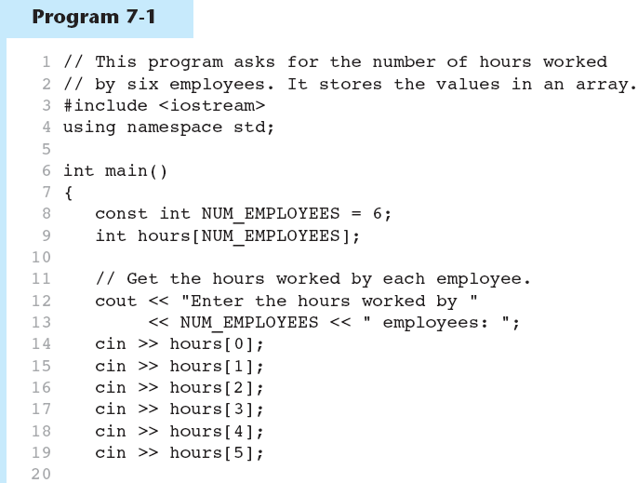
Example 1
PAGE 8

Slide 9
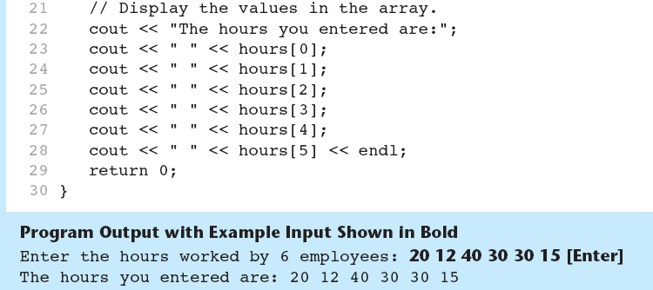
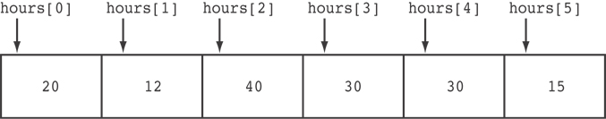
Example 1 (continued)
Here are the contents of the hours array, with the values entered by the user in the example output:
PAGE 9

Slide 10
More info
[1] cplusplus.com: Arrays
https://www.cplusplus.com/doc/tutorial/arrays/
[2] learncpp.com: 6.1 – Arrays (Part I)
https://www.learncpp.com/cpp-tutorial/61-arrays-part-i/
PAGE 10

Slide 11
Accessing Array Contents
ELEC1006 ENGINEERING COMPUTING

Slide 12
Accessing Array Contents
Can access element with a constant or literal subscript:
cout << tests[3] << endl;
Can use integer expression as subscript:
int i = 5;
cout << tests[i] << endl;
PAGE 12

Slide 13
Using a Loop to Step Through an Array
Example – The following code defines an array, numbers, and assigns 99 to each element:
const int ARRAY_SIZE = 5;
int numbers[ARRAY_SIZE];
for (int count = 0; count < ARRAY_SIZE; count++)
numbers[count] = 99;
PAGE 13

Slide 14
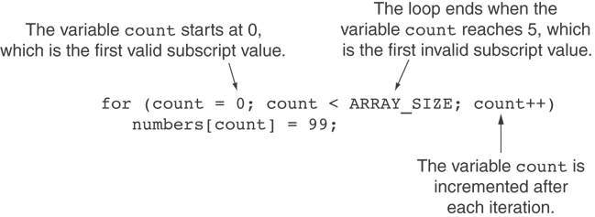
A Closer Look at the Loop
PAGE 14

Slide 15
Default Initialisation
Global array → all elements initialized to 0 by default
Local array → all elements uninitialized by default
PAGE 15

Slide 16
No Bounds Checking in C++
When you use a value as an array subscript, C++ does not check it to make sure it is a valid subscript.
In other words, you can use subscripts that are beyond the bounds of the array.
PAGE 16

Slide 17
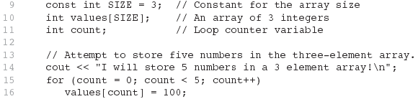
Example 2
The following code defines a three-element array, and then writes five values to it!
PAGE 17

Slide 18
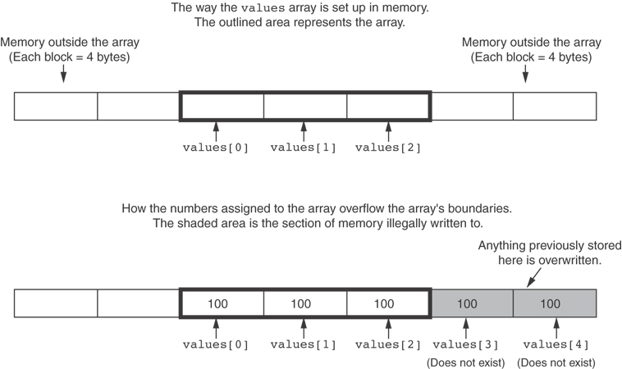
Example 2 (continued)
PAGE 18

Slide 19
No Bounds Checking in C++
Be careful not to use invalid subscripts.
Doing so can corrupt other memory locations, crash program, or lock up computer, and cause elusive bugs.
PAGE 19

Slide 20
Off-by-One Errors
An off-by-one error happens when you use array subscripts that are off by one.
This can happen when you start subscripts at 1 rather than 0:
// This code has an off-by-one error.
const int SIZE = 100;
int numbers[SIZE];
for (int count = 1; count <= SIZE; count++)
numbers[count] = 0;
PAGE 20

Slide 21
More info
[1] cplusplus.com: Arrays
https://www.cplusplus.com/doc/tutorial/arrays/
[2] learncpp.com: 6.3 – Arrays and loops
https://www.learncpp.com/cpp-tutorial/63-arrays-and- loops/
PAGE 21

Slide 22
Array Initialisation & Assignment
ELEC1006: ENGINEERING COMPUTING

Slide 23
Array Initialisation
Arrays can be initialised with an initialisation list: const int SIZE = 5; int tests[SIZE] = {79,82,91,77,84};
The values are stored in the array in the order in which they appear in the list.
The initialisation list cannot exceed the array size.
PAGE 23

Slide 24
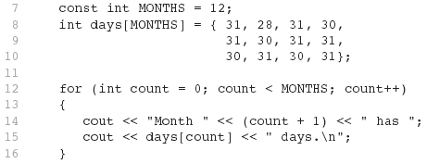
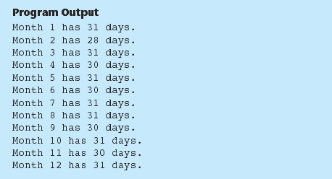
Example 1
PAGE 24

Slide 25
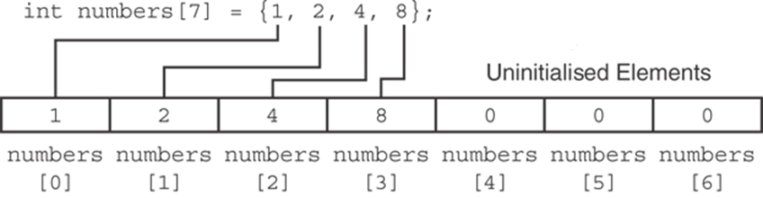
Partial Array Initialisation
If an array is initialised with fewer initial values than the size declarator, the remaining elements will be set to 0:
PAGE 25

Slide 26
Implicit Array Sizing
Can determine array size by the size of the initialisation list:
int quizzes[]={12,17,15,11};
Must use either array size declarator or initialisation list for array definition.
PAGE 26

Slide 27
Initialising an Array with a String
Character array can be initialised by enclosing string in " ":
const int SIZE = 6; char fName[SIZE] = "Henry";
Must leave room for \0 at end of array
If initialising character-by-character, must add in \0 explicitly:
char fName[SIZE] =
{ 'H', 'e', 'n', 'r', 'y', '\0'};
PAGE 27

Slide 28
Array Assignment
To copy one array to another,
Don’t try to assign one array to the other:
newTests = tests; // Won't work
Instead, assign element-by-element:
for (i = 0; i < ARRAY_SIZE; i++)
newTests[i] = tests[i];
PAGE 28

Slide 29
Printing String Contents of an Array
You can display the contents of a character array by sending its name to cout: char fName[] = "Henry";
cout << fName << endl;
But, this ONLY works with character arrays!
PAGE 29

Slide 30
Printing Numeric Contents of an Array
For other types of arrays, you must print element-by-element:
for (i = 0; i < ARRAY_SIZE; i++)
cout << tests[i] << endl;
PAGE 30

Slide 31
More info
[1] cplusplus.com: Arrays
https://www.cplusplus.com/doc/tutorial/arrays/
[2] leanrcpp.com: 6.1 – Arrays (Part I) https://www.learncpp.com/cpp-tutorial/61-arrays-part-i/
[3] learncpp.com: 6.2 – Arrays (Part II)
https://www.learncpp.com/cpp-tutorial/62-arrays-part- ii/
[4] learncpp.com: 6.3 – Arrays and loops
https://www.learncpp.com/cpp-tutorial/63-arrays-and- loops/
PAGE 31

Slide 32
Operations on Arrays
ELEC1006: ENGINEERING COMPUTING

Slide 33
Increment & Decrement Operations on an Array
Array elements can be treated as ordinary variables of the same type as the array.
When using ++, -- operators, don’t confuse the element with the subscript:
tests[i]++; // add 1 to tests[i]
tests[i++]; // increment i, no
// effect on tests
PAGE 33

Slide 34
Summing & Averaging Array Elements
Use a simple loop to add together array elements:
int tnum;
double average, sum = 0;
for(tnum = 0; tnum < SIZE; tnum++)
sum += tests[tnum];
Once summed, the average can be calculated immediately outside the loop:
average = sum / SIZE;
PAGE 34

Slide 35
Finding the Highest Value in an Array
int count;
int highest;
highest = numbers[0];
for (count = 1; count < SIZE; count++)
{
if (numbers[count] > highest)
highest = numbers[count];
}
When this code execution is finished, the highest variable will contain the largest value from the numbers array.
PAGE 35

Slide 36
Finding the Lowest Value in an Array
int count;
int lowest;
lowest = numbers[0];
for (count = 1; count < SIZE; count++)
{
if (numbers[count] < lowest)
lowest = numbers[count];
}
When this code is finished, the lowest variable will contain the smallest value in the numbers array.
PAGE 36

Slide 37
Comparing Arrays
To compare two arrays, you must compare element-by-element:
const int SIZE = 5;
int firstArray[SIZE] = { 5, 10, 15, 20, 25 };
int secondArray[SIZE] = { 5, 10, 15, 20, 25 };
bool arraysEqual = true; // Flag variable
int count = 0; // Loop counter variable
// Compare the two arrays.
while (arraysEqual && count < SIZE)
{
if (firstArray[count] != secondArray[count])
arraysEqual = false;
count++;
}
if (arraysEqual)
cout << "The arrays are equal.\n";
else
cout << "The arrays are not equal.\n";
PAGE 37

Slide 38
Partially-Filled Arrays
If it is unknown how much data an array will be holding:
Make the array large enough to hold the largest expected number of elements.
Use a counter variable to keep track of the number of items stored in the array.
PAGE 38

Slide 39
More info
[1] cplusplus.com: Arrays
https://www.cplusplus.com/doc/tutorial/arrays/
[2] leanrcpp.com: 6.1 – Arrays (Part I) https://www.learncpp.com/cpp-tutorial/61-arrays-part-i/
[3] learncpp.com: 6.2 – Arrays (Part II)
https://www.learncpp.com/cpp-tutorial/62-arrays-part- ii/
[4] learncpp.com: 6.3 – Arrays and loops
https://www.learncpp.com/cpp-tutorial/63-arrays-and- loops/
PAGE 39

Slide 40
Arrays in a Function
ELEC1006: ENGINEERING COMPUTING

Slide 41
Arrays as Function Arguments
When passing an array to a function, it is common to pass array size so that a function knows how many elements to process:
showScores(tests, ARRAY_SIZE);
Array size must also be reflected in prototype, header:
void showScores(int [], int);
// function prototype
void showScores(int tests[], int size)
// function header
PAGE 41

Slide 42
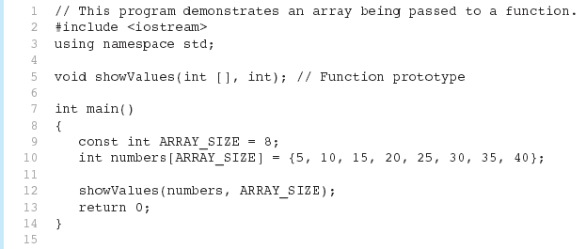
Example 1
(Program Continues)
PAGE 42

Slide 43
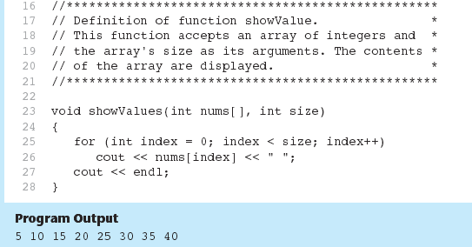
Example 1 (continued)
PAGE 43

Slide 44
Modifying Arrays in a Function
Array names in functions are like reference variables – changes made to array in a function are reflected in the actual array in the calling function.
Need to exercise caution that array is not inadvertently changed by a function.
PAGE 44

Slide 45
More info
[1] cplusplus.com: Arrays
https://www.cplusplus.com/doc/tutorial/arrays/
[2] leanrcpp.com: 6.1 – Arrays (Part I) https://www.learncpp.com/cpp-tutorial/61-arrays-part-i/
[3] learncpp.com: 6.2 – Arrays (Part II)
https://www.learncpp.com/cpp-tutorial/62-arrays-part- ii/
[4] learncpp.com: 6.3 – Arrays and loops
https://www.learncpp.com/cpp-tutorial/63-arrays-and- loops/
PAGE 45

Slide 46
Arrays in a Function
ELEC1006 ENGINEERING COMPUTING

Slide 47
Arrays as Function Arguments
When passing an array to a function, it is common to pass array size so that a function knows how many elements to process:
showScores(tests, ARRAY_SIZE);
Array size must also be reflected in prototype, header:
void showScores(int [], int);
// function prototype
void showScores(int tests[], int size)
// function header
PAGE 47

Slide 48
Example 1
(Program Continues)
PAGE 48

Slide 49
Example 1 (continued)
PAGE 49

Slide 50
Modifying Arrays in a Function
Array names in functions are like reference variables – changes made to array in a function are reflected in the actual array in the calling function.
Need to exercise caution that array is not inadvertently changed by a function.
PAGE 50

Slide 51
More info
[1] cplusplus.com: Arrays
https://www.cplusplus.com/doc/tutorial/arrays/
[2] leanrcpp.com: 6.1 – Arrays (Part I) https://www.learncpp.com/cpp-tutorial/61-arrays-part-i/
[3] learncpp.com: 6.2 – Arrays (Part II)
https://www.learncpp.com/cpp-tutorial/62-arrays-part- ii/
[4] learncpp.com: 6.3 – Arrays and loops
https://www.learncpp.com/cpp-tutorial/63-arrays-and- loops/
PAGE 51

Slide 52
2D Arrays in a Function
ELEC1006: ENGINEERING COMPUTING

Slide 53
2D Array Initialisation
Two-dimensional arrays are initialised row-by-row: const int ROWS = 2, COLS = 2; int exams[ROWS][COLS] = { {84, 78},
{92, 97} };
Can omit inner { }, some initial values in a row – array elements without initial values will be set to 0 or NULL
PAGE 53

Slide 54
2D Array as Argument & Parameter
Use array name as argument in function call:
getExams(exams, 2);
Use empty [] for row, size declarator for column in prototype, header: const int COLS = 2; // Prototype void getExams(int [][COLS], int); // Header void getExams(int exams[][COLS], int rows)
PAGE 54

Slide 55
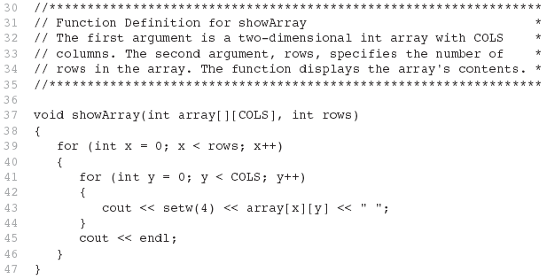
Example 1: The showArray Function
PAGE 55

Slide 56
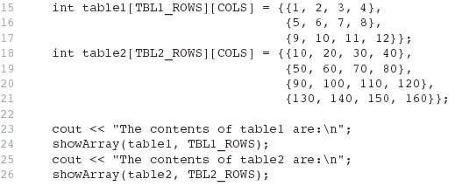
How showArray is Called
PAGE 56

Slide 57
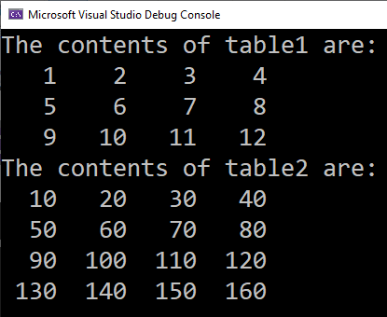
Example 1 Output
PAGE 57

Slide 58
More info
[1] cplusplus.com: Arrays
https://www.cplusplus.com/doc/tutorial/arrays/
[2] leanrcpp.com: 6.1 – Arrays (Part I) https://www.learncpp.com/cpp-tutorial/61-arrays-part-i/
[3] learncpp.com: 6.2 – Arrays (Part II)
https://www.learncpp.com/cpp-tutorial/62-arrays-part- ii/
[4] learncpp.com: 6.3 – Arrays and loops
https://www.learncpp.com/cpp-tutorial/63-arrays-and- loops/
PAGE 58

Slide 59
Operations on 2D Arrays
ELEC1006: ENGINEERING COMPUTING

Slide 60
2D Array Initialisation
Given the following definitions:
const int NUM_STUDENTS = 3;
const int NUM_SCORES = 5;
double total = 0.0; // Accumulator
double average; // To hold average scores
double scores[NUM_STUDENTS][NUM_SCORES] =
{{88, 97, 79, 86, 94},
{86, 91, 78, 79, 84},
{82, 73, 77, 82, 89}};
PAGE 60

Slide 61

Example 1: Summing all Elements in a 2D Array
// Sum the array elements.
for (int row = 0; row < NUM_STUDENTS; row++)
{
for (int col = 0; col < NUM_SCORES; col++)
total += scores[row][col];
}
// Display the sum.
cout << "The total score for all students is " << total << endl;
PAGE 61

Slide 62
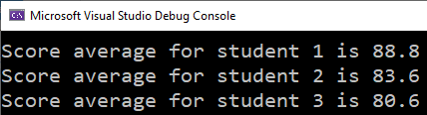
Example 2: Summing the columns of the 2D Array
// Get each student's average score.
for (int row = 0; row < NUM_STUDENTS; row++)
{
// Set the accumulator.
total = 0;
// Sum a row.
for (int col = 0; col < NUM_SCORES; col++)
total += scores[row][col];
// Get the average
average = total / NUM_SCORES;
// Display the average.
cout << "Score average for student "
<< (row + 1) << " is " << average <<endl;
}
PAGE 62

Slide 63
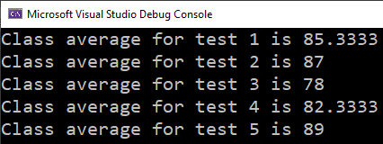
Example 3: Summing the rows of the 2D Array
// Get the class average for each score.
for (int col = 0; col < NUM_SCORES; col++)
{
// Reset the accumulator.
total = 0;
// Sum a column
for (int row = 0; row < NUM_STUDENTS; row++)
total += scores[row][col];
// Get the average
average = total / NUM_STUDENTS;
// Display the class average.
cout << "Class average for test " << (col + 1)
<< " is " << average << endl;
}
PAGE 63

Slide 64
More info
[1] cplusplus.com: Arrays
https://www.cplusplus.com/doc/tutorial/arrays/
[2] leanrcpp.com: 6.1 – Arrays (Part I) https://www.learncpp.com/cpp-tutorial/61-arrays-part-i/
[3] learncpp.com: 6.2 – Arrays (Part II)
https://www.learncpp.com/cpp-tutorial/62-arrays-part- ii/
[4] learncpp.com: 6.3 – Arrays and loops
https://www.learncpp.com/cpp-tutorial/63-arrays-and- loops/
PAGE 64

Slide 65
2D String Array
ELEC1006: ENGINEERING COMPUTING

Slide 66
2D String Array
Use a two-dimensional array of characters as an array of strings: const int NAMES = 3, SIZE = 10; char students[NAMES][SIZE] =
{ "Ann", "Bill", "Cindy" };
Each row contains one string
Can use row subscript to reference the string in a particular row:
cout << students[i];
PAGE 66

Slide 67
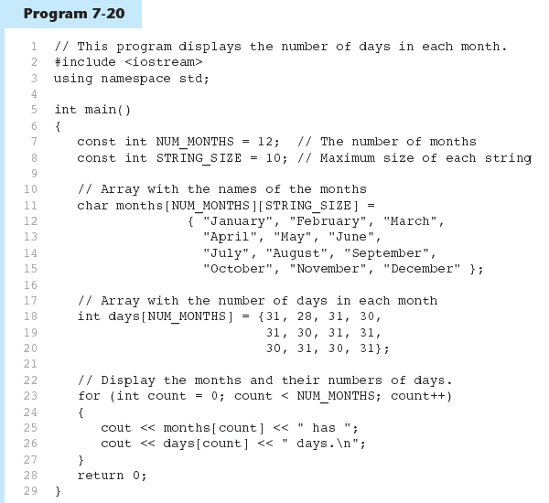
Example 1
PAGE 67

Slide 68
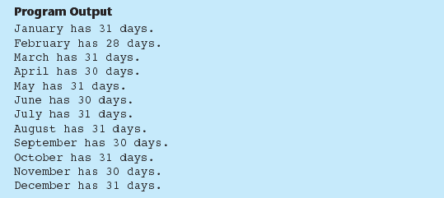
Example 1 Output
PAGE 68

Slide 69
More info
[1] cplusplus.com: Arrays
https://www.cplusplus.com/doc/tutorial/arrays/
[2] leanrcpp.com: 6.1 – Arrays (Part I) https://www.learncpp.com/cpp-tutorial/61-arrays-part-i/
[3] learncpp.com: 6.2 – Arrays (Part II)
https://www.learncpp.com/cpp-tutorial/62-arrays-part- ii/
[4] learncpp.com: 6.3 – Arrays and loops
https://www.learncpp.com/cpp-tutorial/63-arrays-and- loops/
PAGE 69

